Slide 1
Exploring Cellular Automata: From Simple Rules to Complex Patterns

Slide 2
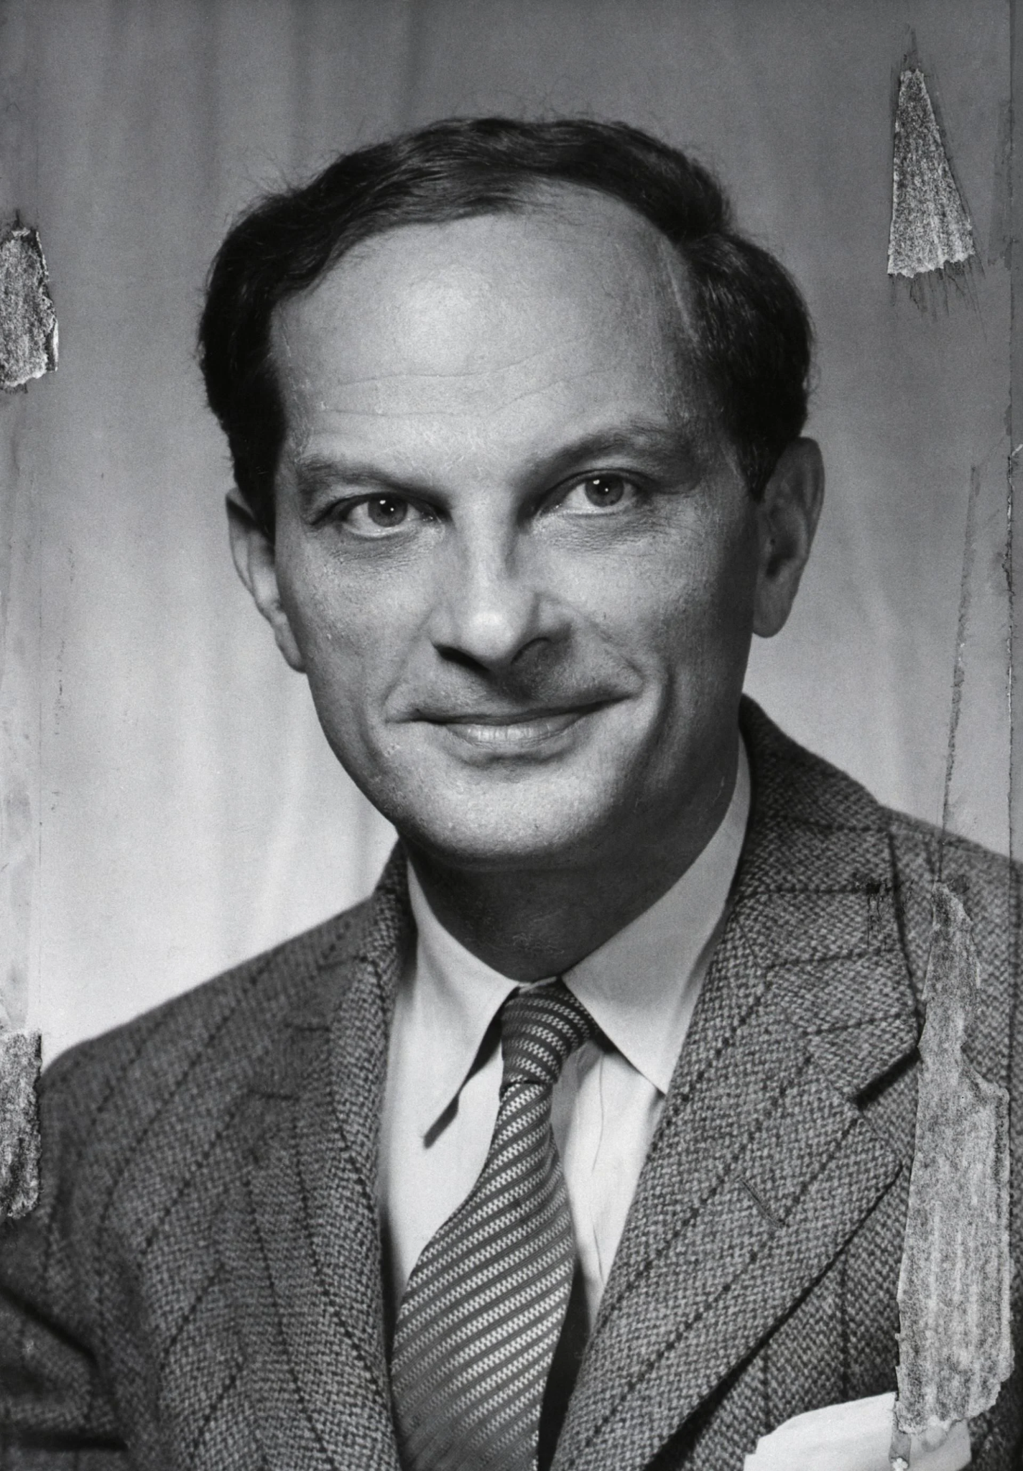

Introduction
Cellular automaton is a collection of cells that can be arranged in a grid where each cell changes their state according to a set of rules given by the neighboring cells.
Original concept created in 1940s by Stanislaw Ulam and John von Neumann.

Slide 3
Motivation
Can simple rules lead to complex behavior?
Produce complexity pattern and behaviors from a set of simple rule.
Help to define unpredictability in cellular automatons.
Design efficient algorithms for evolution of each cell in a large grid.
Explore different kind of pattern and its properties.
Explore complex cellular automaton such as Brian’s Brain.

Slide 4
Problem Statement
Investigate 10 elementary cellular automaton rules
Including Rule 110 & Rule 4
How do different rules produce different behaviors?
Which behaviors are common or rare?
Do patterns generalize across systems?
For a complex cellular automaton, how does the pattern interact and behave?

Slide 5
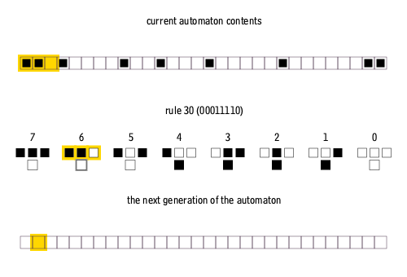
Related Work
Elementary CA
Wolfram’s 256 rules
4 behavior classes (From uniform, repetitive, random, to complex yet with dissipative structure)
Behavior types observed across systems
Brian’s Brain CA
Used Moore neighborhood (8 neighbors)
3 states (ON, OFF and DYING)
OFF -> ON, when exactly two ON neighbors
ON -> DYING, DYING -> OFF
Notes:
ECA: Periodic for Boundary Condition

Slide 6
Approach
Used Python and used Pygame and Numpy libraries.
For elementary CA,
Convert rule number to 8 bit binary string and update rows for new state of the cells.
For complex CA (Brian’s Brain),
Randomly assigns 0 or 1 to each cell in the grid with a probability of 0.8 for 0 (OFF) and 0.2 for 1 (ON).
The grid is then updated to check the status of the neighbors and determine the new state of the cells to be 0 (OFF), 1 (ON), or 2 (DYING).
This would then draw the grid out with the current cells.

Slide 7
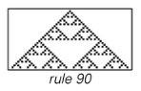
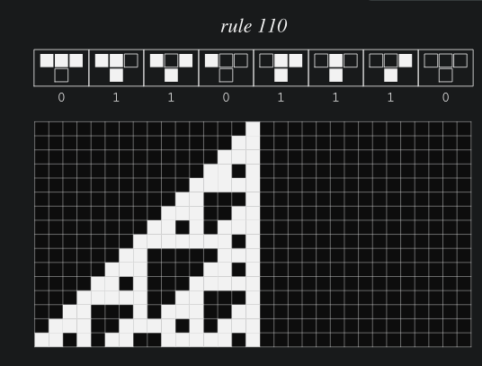
System Examples
Rule 30 → Pseudo-random
Rule 90 & 150 → Fractal Nesting
Rule 110 → Localized Structures
Rule 4 & 123→ Stabilized repetition

Slide 8
Results
Most rules = Uniform, repetition or nesting
About 14% showed complicated patterns
~10% showed randomness (Class 3)
<5% showed complex localized behavior (Class 4)
Rule 30 = Famous Class 3 example
Rule 110 = Famous Class 4 example
Class 1: Rapidly converge to a uniform state.
Class 2: Rapidly converge to a repetitive or stable state.
Class 3: Appear to remain in a random state.
Class 4: Form areas of repetitive or stable states, but also form structures that interact in complicated ways.

Slide 9
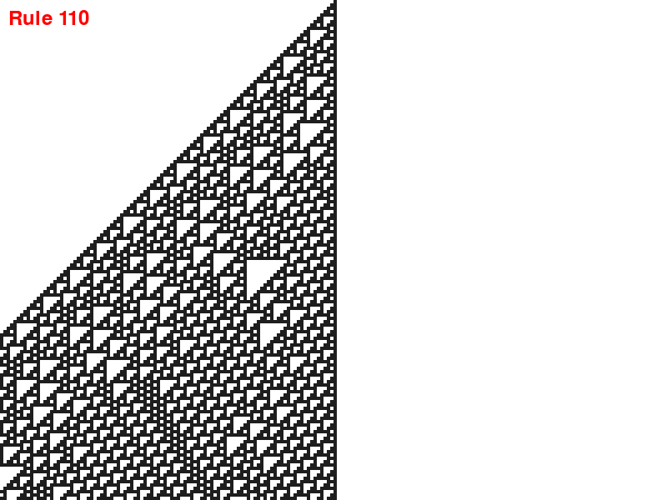
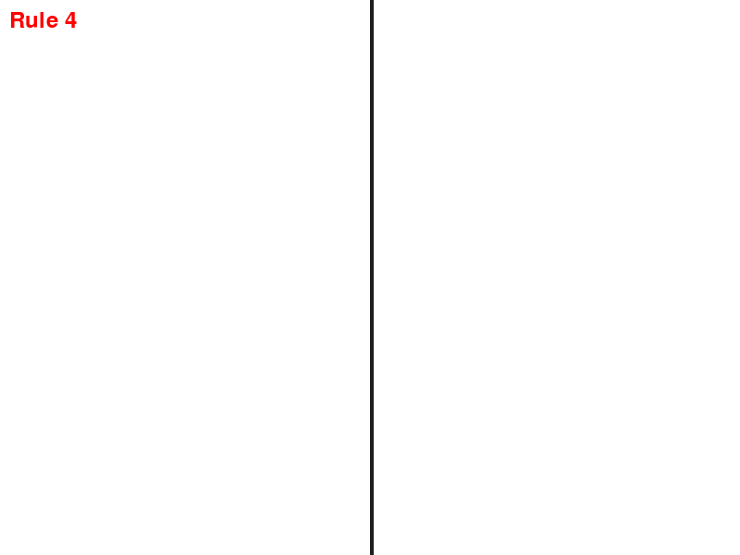
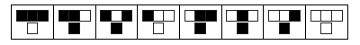
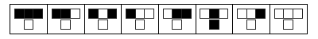
Results

Slide 10
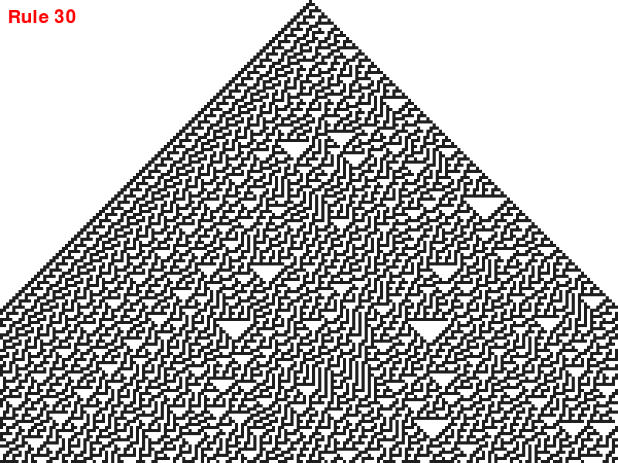
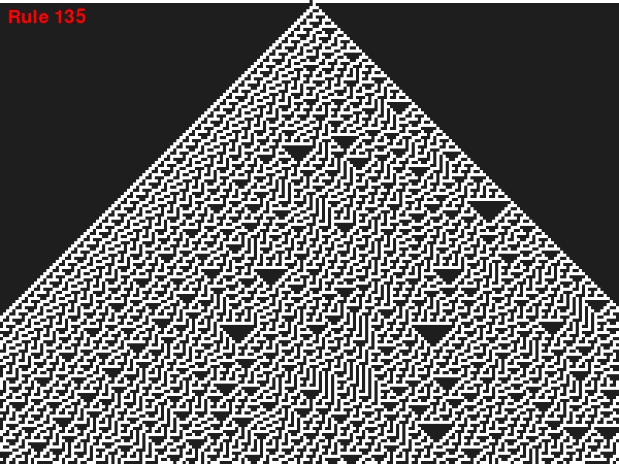
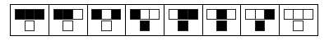
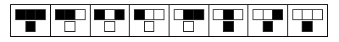
Results

Slide 11
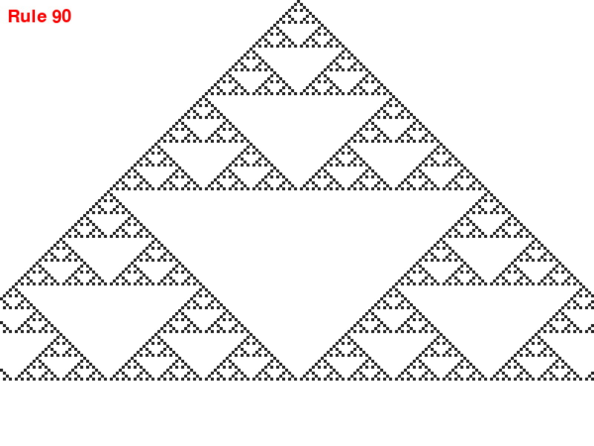

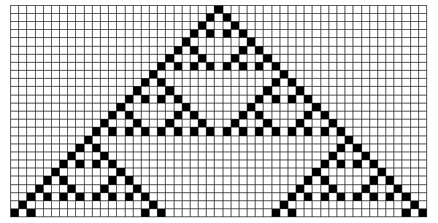
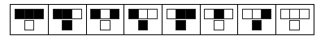
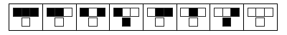
Results

Slide 12
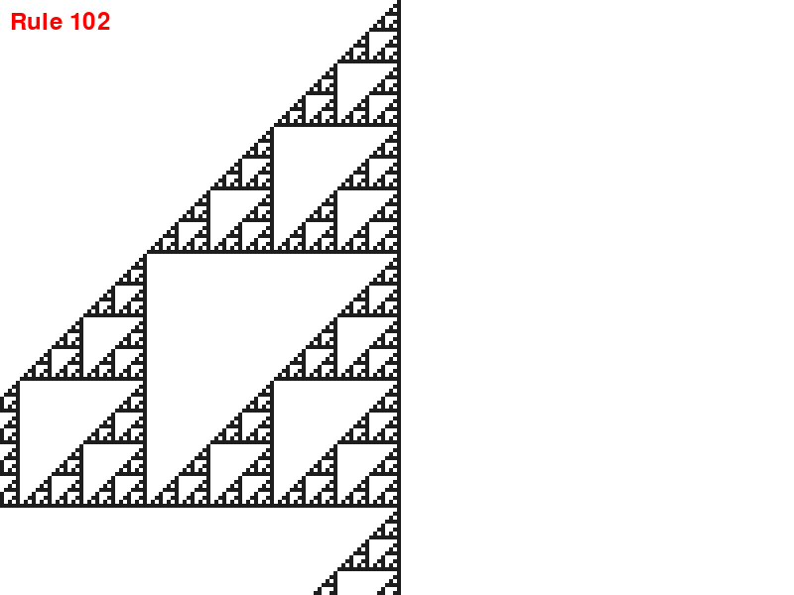
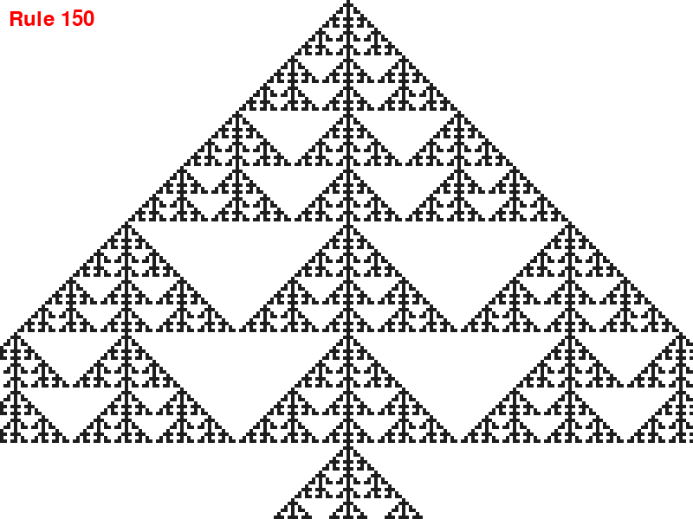
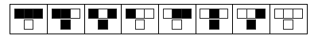
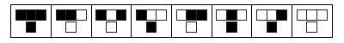
Results

Slide 13
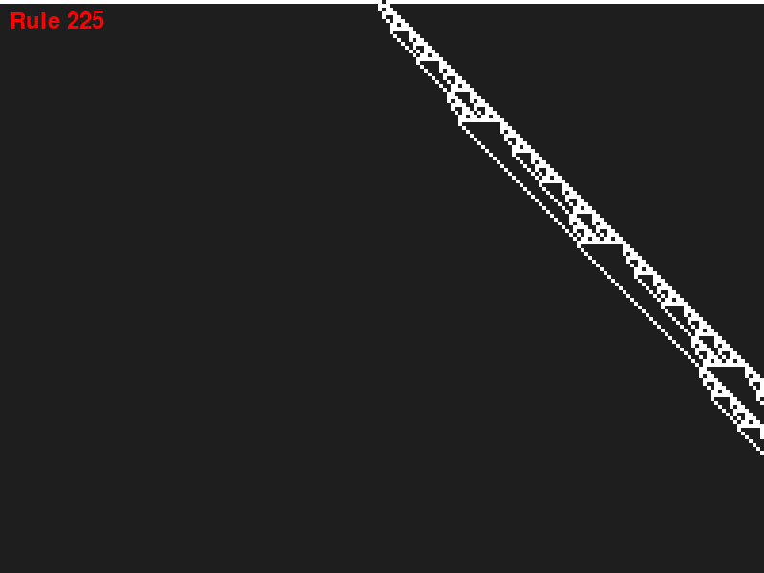
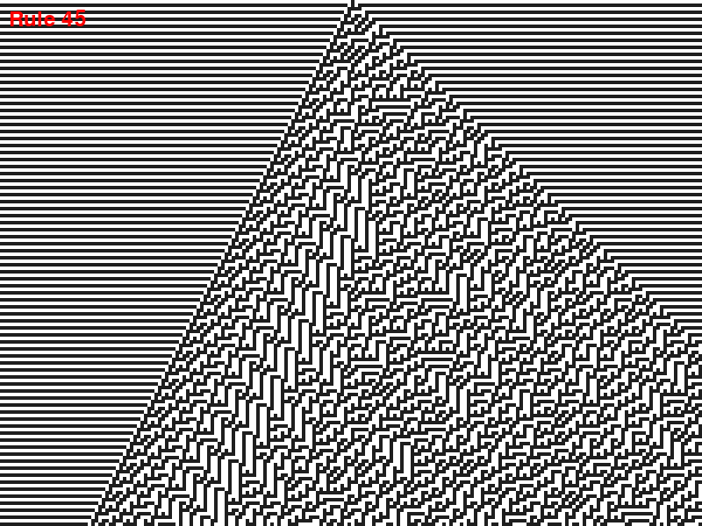
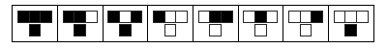
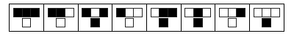
Results
Notes:
Rule 225 - Width of the pattern scale by square root of the number of steps.

Slide 14
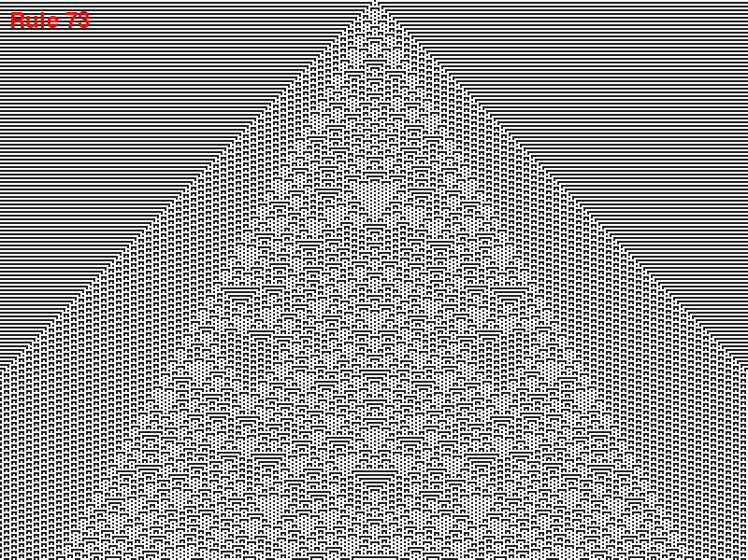

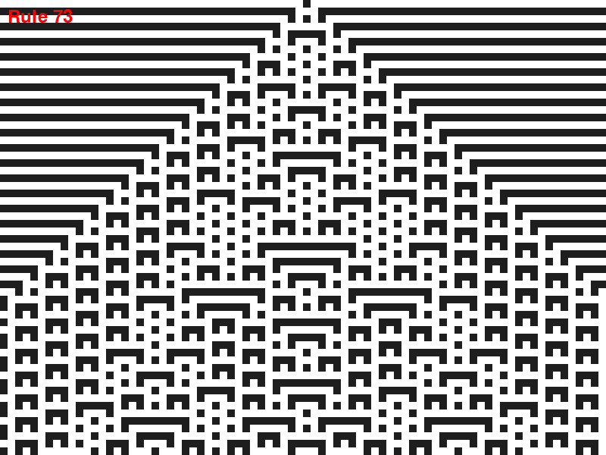
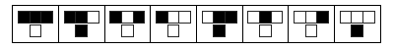
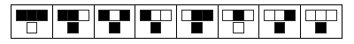
Results

Slide 15
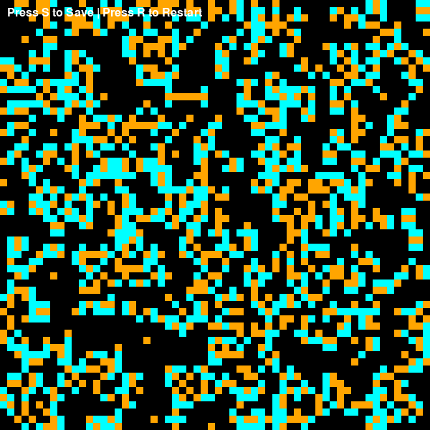
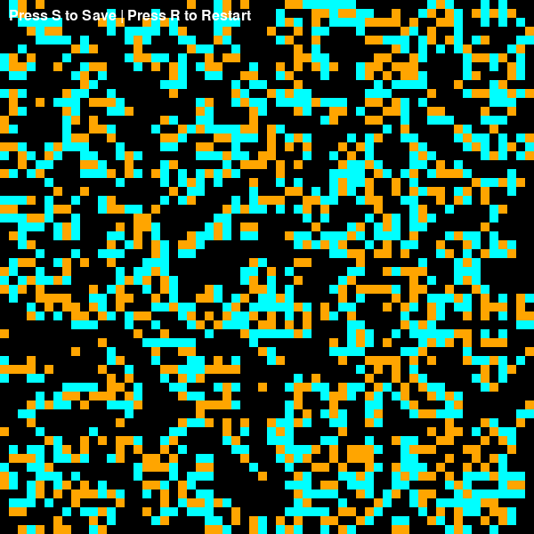
Brian’s Brain Results

Slide 16
Conclusion and Contributions
For Elementary Cellular Automata,
Observed how simple rules lead to complex patterns from a single active cell.
Some rules generated chaotic, repetitive, or even fractal-like structures.
Used in cryptography, pattern generation, and modeling computation with minimal resources.
For Brian’s Brain Cellular Automata,
Unlike Conway's Game of Life, Brian's Brain maintains constant movement, with no static patterns.
Highlights how simple neuron-inspired rules can create self-perpetuating, chaotic motion.
Used in modeling neural firing, wavefront propagation, and spatial feedback systems.

